Slide 1
Presentation to the Member Units of the
Worcester Regional Retirement System
Fiscal Year 2023 Appropriations
January 20, 2022
Presented by
Linda L. Bournival, FSA
Consulting Actuary

Slide 2
Agenda
Introduction
Most Recent Valuation - January 1, 2020
Member Unit Statements
Summary of Member Unit Data
FY23 Appropriations
Why the increase?
Next Valuation – January 1, 2022
GASB Statements 67 and 68
Funding and GASB 68
Cost of New Entrant
Questions

Slide 3
Introduction
Linda L. Bournival, FSA, EA, MAAA
Actuarial Credentials
Fellow of the Society of Actuaries
Enrolled Actuary under ERISA
Member of the American Academy of Actuaries
Fellow of the Conference of Consulting Actuaries
Over 30 years of Actuarial & Benefits Consulting Experience
Public Pension valuation and consulting experience
Conducted actuarial audits of large state pension and healthcare systems
Pension Obligation Bond consulting and actuarial analysis
Retiree healthcare (OPEB) valuations
Cities, Towns, Counties, School Districts, Enterprise Units, Housing Authorities and a state university system

Slide 4
Most Recent Valuation – January 1, 2020
Liabilities developed as of January 1, 2020
Membership data as of December 31, 2019
Market value of assets as of December 31, 2019
Results used to develop
FY22 and FY23 appropriations
Used actuarial method to allocate amongst member units
GASB 67 disclosures – 2020 and 2021
GASB 68 disclosures – FY21 and FY22

Slide 5
Member Unit Statements
Statement prepared for each contributing Member Unit
2020 valuation results the basis for appropriations
FY22 and FY23
Contents
Summary of Member Data
Valuation Results as of January 1, 2020
Employer Normal Cost
Unfunded Actuarial Accrued Liability
FY23 appropriations

Slide 6
Summary of Member Unit Data
Valuation Results are only as good as the data used
Active member data
Pensionable compensation
Birth date
Membership date
Gender
Member contribution rate
Retired member data
Pension benefit
Birth date
Gender
Option C beneficiary birth date and gender

Slide 7
Summary of Member Unit Data
Fractional member = multi-unit member
Salaries from different units (for same member) are totaled to develop benefits
Salaries broken out by unit to develop appropriation

Slide 8
Valuation Results by Member Unit
Normal cost is the present value of the benefits earned by active members during the current year
Actuarial Accrued Liability (AAL) is the present value of benefits earned as of the valuation date
Assets are allocated to each member unit based on the AAL
Unfunded Actuarial Accrued Liability = AAL less Actuarial Value of Assets

Slide 9
FY23 Appropriations
Update payments for 2002, 2003 and 2010 ERIs
Actual Liabilities developed for each member
Total liabilities by Member Unit
Actuarial Value of Assets allocated to each Member Unit
Appropriation consists of
Employer Normal Cost (cost of benefits earned during the year)
Amortization Payment towards Unfunded Actuarial Accrued Liability
ERI Payments
Expected Net 3(8)(c) transfers
Administrative Expenses

Slide 10
FY23 Appropriations
Increased $7.4 million over FY22 appropriation (9.95%)
Current Appropriation Schedule caps increases from year to year at 9.95%
Normal cost increased 2.8%
Amortization Payments
Unfunded Actuarial Accrued Liability increased by 13.5%
ERI 2002 and ERI 2003 increased by 4.5%
ERI 2010 decreased to 0.
Offer “early payment” discount if total appropriation paid by July 1, 2022
Examples of hypothetical member units’ increases for FY23 (next slide)

Slide 11
Why the Increase?
10.83% Increase from FY22 to FY23
Component | FY22 | FY23
Normal cost | $200,000 | $200,000 + 2.8% = $205,600
Amortization | $600,000 | $600,000 + 13.5% = $681,000
Total | $800,000 | $886,600 = 10.83% increase
6.37% Increase from FY22 to FY23
Component | FY22 | FY23
Normal cost | $200,000 | $200,000 + 2.8%= $205,600
Amortization | $100,000 | $100,000 + 13.5% = $113,500
Total | $300,000 | $319,100 = 6.37% increase

Slide 12
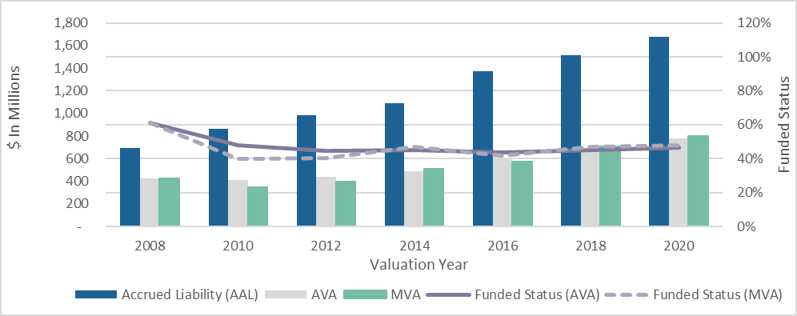
10-Year History of Funded Status

Slide 13
Sources of Changes in Unfunded Accrued Liability
($ in millions)
Valuation as of Jan 1 | 2010* | 2012 | 2014 | 2016 | 2018 | 2020
Passage of time | 8.32 | 14.77 | 19.61 | 8.60 | 37.54 | 25.16
Benefit changes | 9.36 | 0.00 | 12.10 | 24.23 | 0.55 | 0.00
Assumption changes | (27.53) | 4.77 | 3.69 | 113.03 | 0.00 | 24.91
Actuarial (gains) and losses | 49.80 | 23.77 | (5.21) | 33.35 | 19.33 | 3.16
Asset (gains) and losses | 106.06 | 53.79 | 23.11 | (4.03) | (2.90) | 16.20
Total * Based on 3 years | 146.01 | 97.10 | 53.30 | 175.18 | 54.52 | 69.43

Slide 14
GASB Statements 67 and 68
GASB = Governmental Accounting Standards Board
GASB 67 was implemented in 2014 calendar year
Applies to the Worcester Regional Retirement System
Disclosures required for each calendar year, beginning 2014
GASB 68 was implemented in fiscal year beginning July 1, 2014
Applies to contributing employers of the Worcester Regional Retirement System
Breaks the link between Funding Policy and Accounting Expense
Funded Status of plan appears on employer’s balance sheet
Additional financial statement notes and supplementary information to be disclosed, including 10-year history

Slide 15
Funding and GASB 68
The liabilities and other information are not the same!
 | Funding | GASB 68
Liabilities | Developed as of January 1, 2020 | Rolled forward to December 31, 2020
Appropriations | Based on Chapter 32 Allocated to member units based on actuarial method | Not applicable
Pension Expense | Not applicable | Based on GASB 68 Allocated to member units based on FY21 appropriations actually paid

Slide 16
Next Valuation – January 1, 2022
Liabilities developed as of January 1, 2022
Membership data as of December 31, 2021
Market value of assets as of December 31, 2021
Results used to develop
FY24 and FY25 appropriations
Used actuarial method to allocate amongst member units
GASB 67 disclosures
GASB 68 disclosures

Slide 17
Cost of New Entrant
Normal cost is the cost of benefits earned during the current year
The amounts in the table below represent the average normal costs for a new hire at the specified ages in the year of hire, based on member group classification:
Age | Group 1 | Group 4
25 | $0 | $3,800
35 | $300 | $6,300
45 | $1,500 | $8,900
The normal cost increases annually by approximately 3% until retirement

Slide 18
Questions?

