Slide 1
Presentation to the Member Units of the
Worcester Regional Retirement System
Fiscal Year 2024 Appropriations
January 19, 2023
Presented by
Linda L. Bournival, FSA
Consulting Actuary

Slide 2
Agenda
Introduction
Most Recent Valuation - January 1, 2022
Member Unit Statements
Summary of Member Unit Data
FY24 Appropriations
Why the increase?
GASB Statements 67 and 68
Funding and GASB 68
5% COLA impact
Pensionomics 2023
Questions

Slide 3
Introduction
Linda L. Bournival, FSA, EA, MAAA
Actuarial Credentials
Fellow of the Society of Actuaries
Enrolled Actuary under ERISA
Member of the American Academy of Actuaries
Fellow of the Conference of Consulting Actuaries
Member of the Society of Actuaries “Social Insurance and Public Finance” Council
Over 30 years of Actuarial & Benefits Consulting Experience
Public Pension valuation and consulting experience
Conducted actuarial audits of large state pension and healthcare systems
Pension Obligation Bond consulting and actuarial analysis
Retiree healthcare (OPEB) valuations
Cities, Towns, Counties, School Districts, Enterprise Units, Housing Authorities and a state university system

Slide 4
Most Recent Valuation – January 1, 2022
Liabilities developed as of January 1, 2022
Membership data as of December 31, 2021
Market value of assets as of December 31, 2021
Results used to develop
FY24 and FY25 appropriations
Used actuarial method to allocate amongst member units
GASB 67 disclosures – 2022 and 2023
GASB 68 disclosures – FY23 and FY24

Slide 5
Member Unit Statements
Statement prepared for each contributing Member Unit
2022 valuation results are the basis for appropriations
FY24 and FY25
Contents
Summary of Member Data
Valuation Results as of January 1, 2022
Employer Normal Cost
Unfunded Actuarial Accrued Liability
FY24 appropriations

Slide 6
Summary of Member Unit Data
Valuation Results are only as good as the data used
Active member data
Pensionable compensation
Birth date
Membership date
Gender
Member contribution rate
Retired member data
Pension benefit
Birth date
Gender
Option C beneficiary birth date and gender

Slide 7
Summary of Member Unit Data
Fractional member = multi-unit member
Salaries from different units (for same member) are totaled to develop benefits
Salaries broken out by unit to develop appropriation

Slide 8
Valuation Results by Member Unit
Normal cost is the present value of the benefits earned by active members during the current year
Actuarial Accrued Liability (AAL) is the present value of benefits earned as of the valuation date
Assets are allocated to each member unit based on the AAL
Unfunded Actuarial Accrued Liability = AAL less Actuarial Value of Assets

Slide 9
FY24 Appropriations
Update payments for 2002 and 2003 ERIs
Actual Liabilities developed for each member
Total liabilities by Member Unit
Actuarial Value of Assets allocated to each Member Unit
Appropriation consists of
Employer Normal Cost (cost of benefits earned during the year)
Amortization Payment towards Unfunded Actuarial Accrued Liability
ERI Payments
Expected Net 3(8)(c) transfers
Administrative Expenses

Slide 10
FY24 Appropriations
Increased $8.2 million over FY23 appropriation (9.95%)
Current Appropriation Schedule caps increases from year to year at 9.95%
Normal cost increased 3.5%
Amortization Payments
Unfunded Actuarial Accrued Liability increased by 13.5%
ERI 2002 and ERI 2003 increased by 4.5%
Offer “early payment” discount of 1.72% if total appropriation paid on July 1, 2023
Examples of hypothetical member units’ increases for FY24 (next slide)

Slide 11
Why the Increase?
11% Increase from FY23 to FY24
Component | FY23 | FY24
Normal cost | $200,000 | $200,000 + 3.5% = $207,000
Amortization | $600,000 | $600,000 + 13.5% = $681,000
Total | $800,000 | $888,000 = 11% increase
6.83% Increase from FY23 to FY24
Component | FY23 | FY24
Normal cost | $200,000 | $200,000 + 3.5%= $207,000
Amortization | $100,000 | $100,000 + 13.5% = $113,500
Total | $300,000 | $320,500 = 6.83% increase

Slide 12
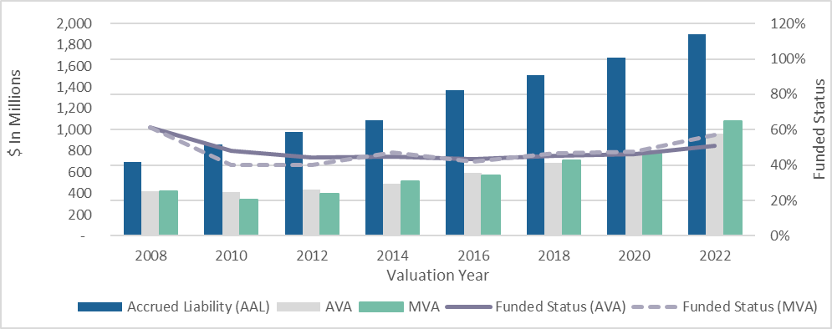
History of Funded Status
From 2008 to 2022, assets increased from $450M to 1.1B
During same period, liabilities increased from $700M to $1.9B
Decrease in investment return assumption (8.5% to 7.25%)
COLA base increases
Mortality improvement

Slide 13
Sources of Changes in Unfunded Accrued Liability
($ in millions)
Valuation as of Jan 1 | 2010* | 2012 | 2014 | 2016 | 2018 | 2020 | 2022
Passage of time | 8.32 | 14.77 | 19.61 | 8.60 | 37.54 | 25.16 | 10.77
Benefit changes | 9.36 | 0.00 | 12.10 | 24.23 | 0.55 | 0.00 | 0.00
Assumption changes | (27.53) | 4.77 | 3.69 | 113.03 | 0.00 | 24.91 | 65.19
Actuarial (gains) and losses | 49.80 | 23.77 | (5.21) | 33.35 | 19.33 | 3.16 | 17.32
Asset (gains) and losses | 106.06 | 53.79 | 23.11 | (4.03) | (2.90) | 16.20 | (57.97)
Total * Based on 3 years | 146.01 | 97.10 | 53.30 | 175.18 | 54.52 | 69.43 | 35.31

Slide 14
Funding and GASB 68
The liabilities and other information are not the same!
 | Funding | GASB 68
Liabilities | Developed as of January 1, 2022 | Rolled forward from January 1, 2020 to December 31, 2021
Appropriations | Based on Chapter 32 Allocated to member units based on actuarial method | Not applicable
Pension Expense | Not applicable | Based on GASB 68 Allocated to member units based on FY22 appropriations actually paid

Slide 15
Cost of New Entrant
Normal cost is the cost of benefits earned during the current year
The amounts in the table below represent the average normal costs for a new hire at the specified ages in the year of hire, based on member group classification:
Age | Group 1 | Group 4
25 | $0 | $4,200
35 | $500 | $7,200
45 | $1,800 | $10,000
The normal cost increases annually by approximately 3.5% until retirement

Slide 16
Additional 2% COLA
Recent legislation allows systems to grant an additional 2% COLA
Retroactive to July 1, 2022
Statute currently allows “0% to 3%” up to the COLA base of $16,000
Additional 2% must be approved by 2/3rd of municipal units
Liabilities are expected to increase by approximately $8.9 million
$8.9 million is an increase of approximately .5% of liabilities
Impact on FY2026 appropriations is an increase of $1.219 million
Future appropriations will increase by approximately 4% until 2033

Slide 17
Cost of Additional 2% COLA - Example
Member Unit Scenario
A member unit has liabilities that represent 5% of the System’s total
The payment toward reducing the unfunded actuarial accrued liability (UAAL) is approximately 5% of the System’s total payment toward reducing the UAAL
Additional 2% COLA granted
member unit has retiree liabilities (including beneficiaries and disabled retirees) of $2,000,000 as shown in the FY2024 Member Unit Statement
Multiply the retiree liabilities times .001188
The estimated increase in the FY2026 payment to provide the additional 2% COLA is $2,376, increasing 4% per year until 2036

Slide 18
Pensionomics 2023
“Measuring the Economic Impact of DB Pension Expenditures”
Annual report prepared by National Institute on Retirement Security
Research on benefits paid by state and local pension plans
Key takeaways
Average Massachusetts public pension was $37,315 in 2020
Between 1993 and 2020
33% of pension fund receipts came from employer contributions
20% from member deductions
47% from investment earnings
https://www.nirsonline.org/reports/pensionomics2023/

Slide 19
Questions?

